Slide 1
SharePoint Framework M12
Jenkins NS
@jenkinsns

Slide 2

Agenda
Module 12: SharePoint Framework Extensions
SharePoint Framework Extensions Overview
Types of Extensions
Creating an application customizer
Creating a field customizer
Creating a command set
SPFx Library
Creating a Library

Slide 3
Introduction
SPFx Extension overview

Slide 4

SPFx Extension
Extend user experience within modern pages & libraries
Customize notification areas, toolbars, and list data views

Slide 5
SharePoint Framework Extensions Overview
You can use SharePoint Framework (SPFx) Extensions to extend the SharePoint user experience. With SPFx Extensions, you can customize more facets of the SharePoint experience, including notification areas, toolbars, and list data views. SPFx Extensions are available in all Microsoft 365 subscriptions for production usage.
SPFx Extensions enable you to extend the SharePoint user experience within modern pages and document libraries, while using the familiar SPFx tools and libraries for client-side development. Specifically, the SPFx includes three extension types:
Application Customizers
Adds scripts to the page, and accesses well-known HTML element placeholders and extends them with custom renderings.
Field Customizers:
Provides modified views to data for fields within a list.
Command Sets:
Extends the SharePoint command surfaces to add new actions and provides client-side code that you can use to implement behaviors.

Slide 6
Application Customizer
Demo

Slide 7
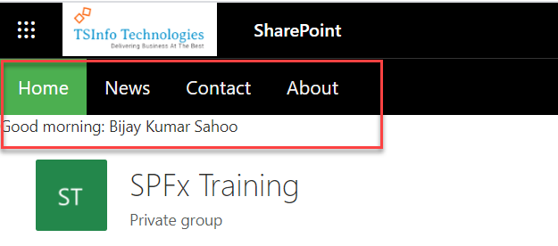
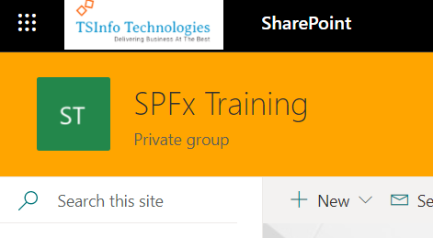
SPFx Application Customizer
By using SPFx application customizers, we can add scripts, access HTML element placeholders, and extend those placeholders.

Slide 8
Field Customizer
Demo

Slide 9
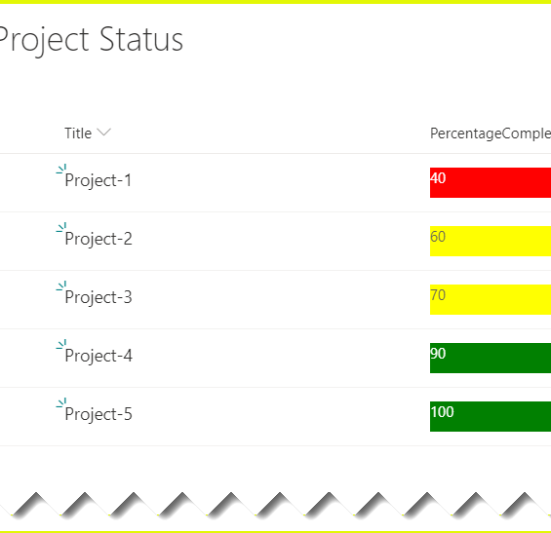
SPFx Field Customizer
By using SPFx field customizers we can modify the list views.
onInit(): The onInit() method get called after this.context and this.properties are assigned, but before the page DOM is ready.
onRenderCell(): onRenderCell() event triggered when each cell is rendered.
onDisposeCell(): onDisposeCell() is used to free up resources that were allocated while rendering.

Slide 10
Listview Command Set Customizer
Demo

Slide 11
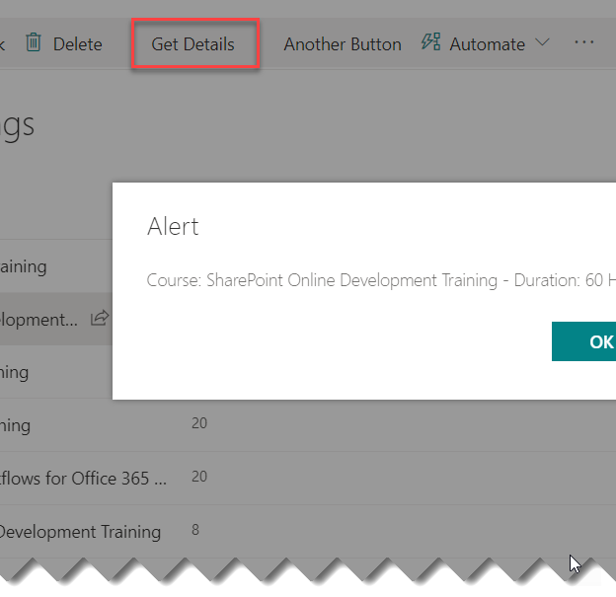
Listview Customizer Command Set
By using command sets, we can add new actions with client-side code to implement the behaviors.
onRenderCell():
onRenderCell() event triggered when each cell is rendered. Here we can use the event.domElement HTML element to extend our functionality.

Slide 13
Demo
Build your first SPFx Extension
Create an Application customizer extension
Create a Field customizer extension
Create a command set extension
Create a Library component for SPFx webpart

Slide 14
References
https://pnp.github.io/pnpjs/sp/

